Slide 1
SIH Team
- Prominence -
Presentation for Problem SIH1348

Slide 2
Problem Statement Break-Down
Problem Statement
“Natural language translation engine for announcements and information dissemination at stations”
Solution
“To Develop a Web based Platform for Stations which can handle the required entities”
Notes:
Main Points are our Dileverables

Slide 3
Problem Statement Break-Down
Deliverables 1. Translation Engine
2. Announcements & Information
4. User Interfaces
5. Multilingual Support
6. Chat Bot & Voice Tech
7. Documentation
8. Mobile Optimization
Notes:
Main Points are our Dileverables

Slide 4
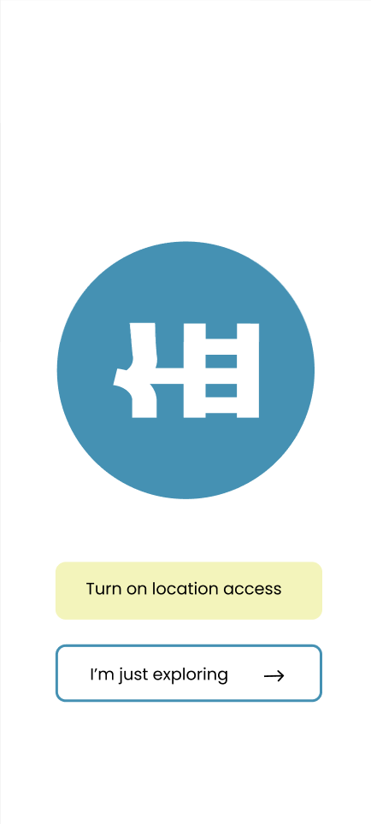
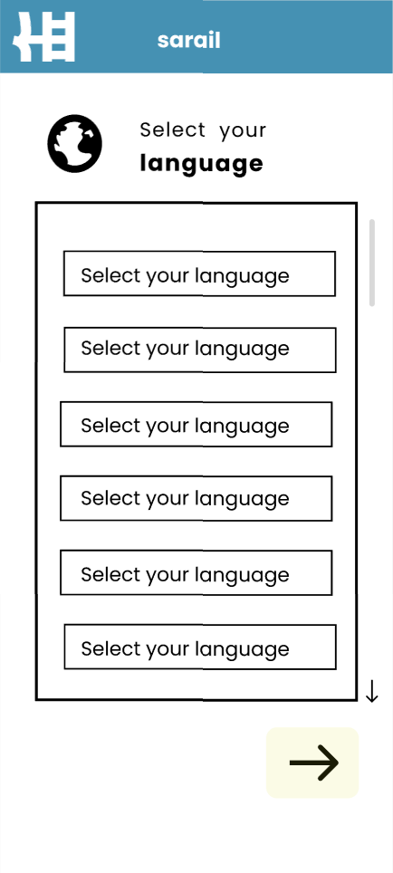
APP Start
We have attached some of Wire-Frames of the Solution.

Slide 5
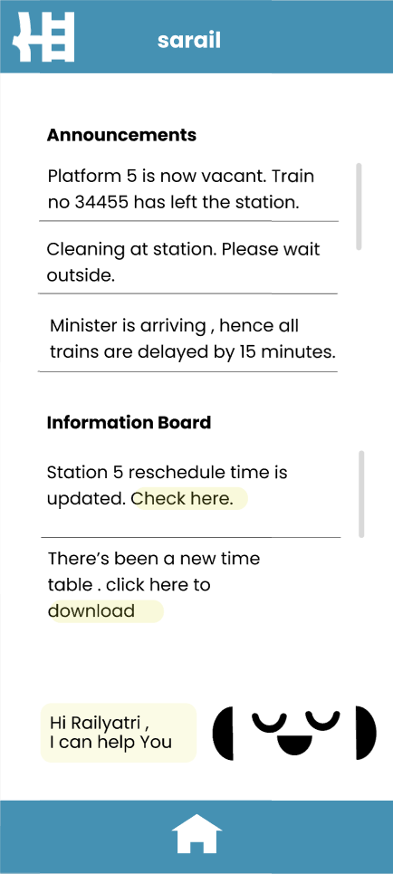
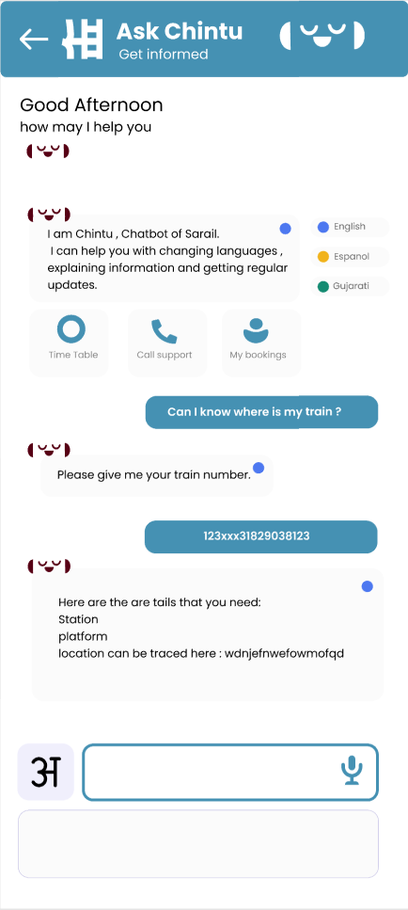
Home
Chat Bot

Slide 6
Steps of Use
Open
1
4
Home
Choose Language
2
5
Chat-Bot
Station
3
6
Voice
You can Now receive the Notification of Announcements
Open the application
For first time SetUp your preferred Language
Select the Chatbot icon to talk or text your questions.
Enter the station for receiving the Announcements
Tap the voice button on the announcements to get the voice output

Slide 7
Description of Deliverables
These are our main focus works
Language Translation | To cover all the Indian Languages and Popular Foreign Languages
Web Based Solution | An assortment of graphic resources that are suitable for use in this presentation
Thanks slide | You must keep it so that proper credits for our design are given
Colors | All the colors used in this presentation
Icons and infographic resources | These can be used in the template, and their size and color can be edited
Editable presentation theme | You can edit the master slides easily. For more info, click here

Slide 8
Thanks!
Do you have any questions?
adi.chat16.codes@gmail.com
Team: Prominence

